Slide 1

Online Fraud Detection ML Project

Slide 2

Overview
Chosen dataset
Reasoning
Basic info about dataset (rows, columns, size)
Steps we took – initial analysis, EDA (findings), model
Insights, Feature engineering
Chosen ML algorithm – via LazyPredict
XGBoost, also tried Isolation Forest
Improvements to model – SMOTE
Results

Slide 3
Chosen Dataset
LINK
Online Payments Fraud Detection
6.36 million rows, 11 columns, 500 MB of data, CSV
We wanted a large enough dataset to challenge Spark and DataBricks, ended up using Pandas anyway
Many shortcomings of Databricks

Slide 4
Chosen Dataset
https://www.kaggle.com/datasets/rupakroy/online-payments-fraud-detection-dataset
Online Payments Fraud Detection
6.36 million rows, 11 columns, 500 MB of data, CSV
We wanted a large enough dataset to challenge Spark and DataBricks, ended up using Pandas anyway
Many shortcomings of Databricks

Slide 5
Initial analysis
Our columns all loaded with object types – needed to be re-typed
No missing values were find
Only a small fraction (0.18%) of all rows were marked as fraud

Slide 6
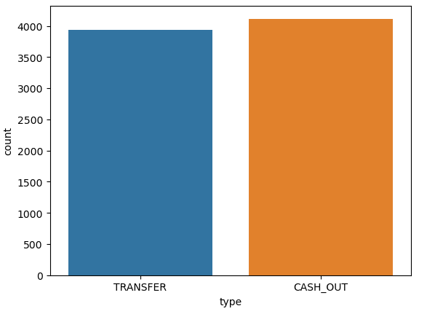
Exploratory Data Analysis Insights
Only types CASH_OUT and
TRANSFER were involved in a fraudulent transactions, with CASH_OUT being slightly more common

Slide 7
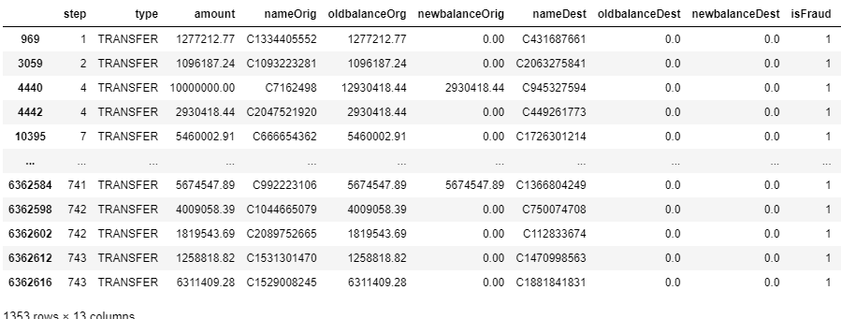
Exploratory Data Analysis - Insights
We found a distinct pattern of transactions being marked as Fraud if both old and new balance on destination accounts were 0

Slide 8
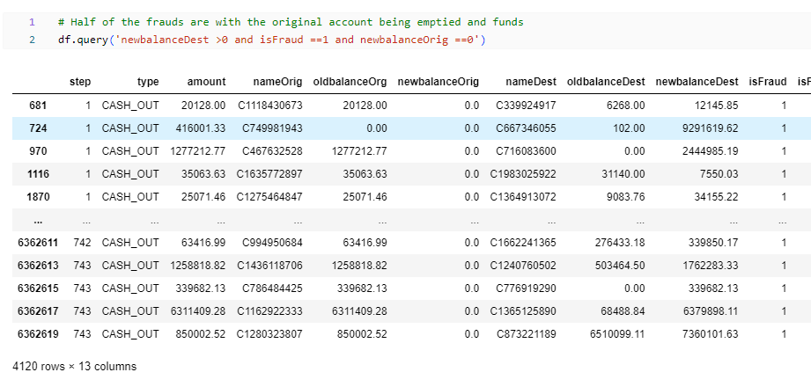
Exploratory Data Analysis - Insights
Most of CASH_OUT Frauds ended with new balance on the original account being 0. The thieves probably picked the stolen account clean.

Slide 9
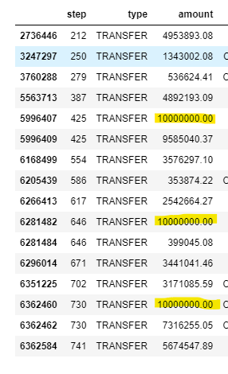
Exploratory Data Analysis - Insights
There was a significant pattern in fraudulent transactions in the amount of 10 million, transfered in several steps

Slide 10
Feature Engineering
Based on EDA, we created a new feature, „IsZero“, which aggregated results from columns oldBalanceDest and newBalancedest, where we found a pattern
Comparing the results with and without this feature, the one with performer better.
We also extracted first letters of nameDest and nameOrigin, which showed us account types (customer vs merchant). This again helped the model perform better.

Slide 11
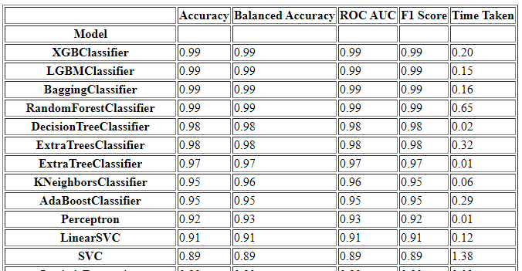
Chosen ML Algorithm
Using LazyPredict, we discovered that XGBoost performed best on our dataset

Slide 12
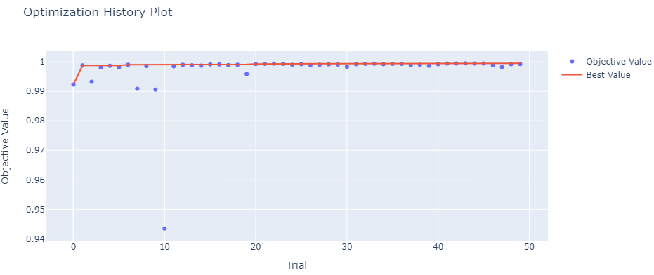
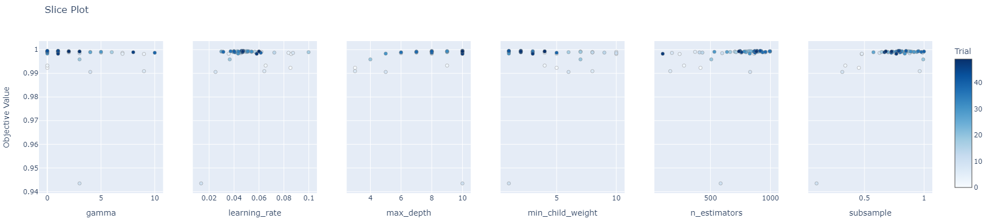
Chosen ML Algorithm
Using Optuna, we tuned the hyperparameters

Slide 13
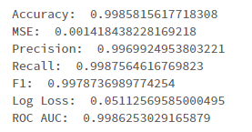
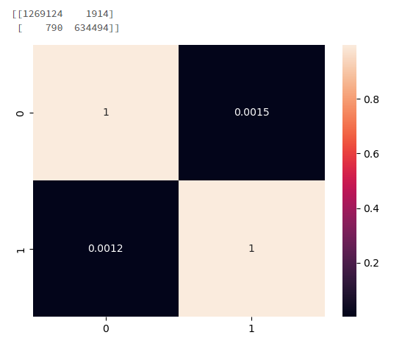
Results
Validation score:

Slide 14

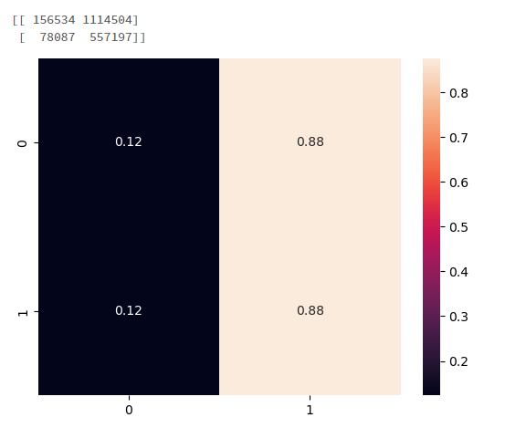
Alternative ML algorithm
We tried the same using IsolationForest, which is often used for Fraud detection tasks
However, it did not perform as well as XGBoost

Slide 15
Improvements to our model
SMOTE - Synthetic Minority Oversampling Technique part of Imblearn library
We used SMOTE to try these 3 approaches:
Undersampling – to reduce computing time
Oversampling – to see if it performs better. It was taking too much time, so we decided to go with number 3:
Undersampling majority class + oversampling minority class – this balanced the dataset by lowering the number of most prevalent values and increasing the number of least present values.
Approach number 3 produced the best results at the cost of significant computation time.

Slide 16
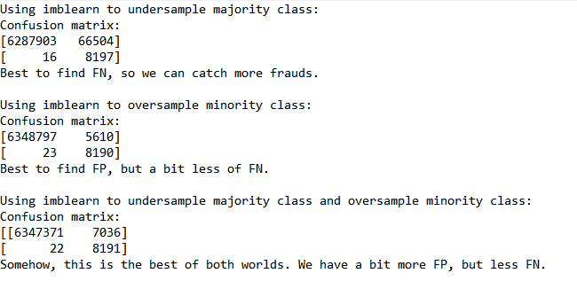
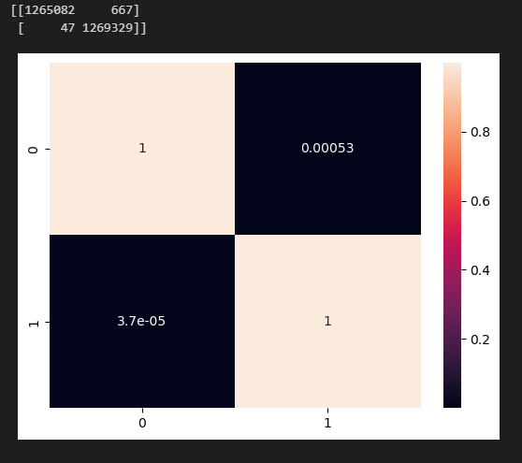
Results

Slide 17
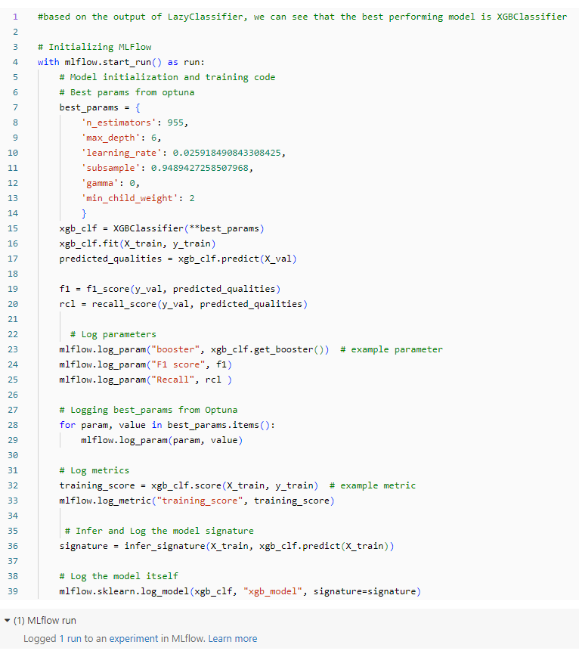
MLFlow implementation
The existing code was amended to allow for MLFlow logging in DataBricks.

Slide 18
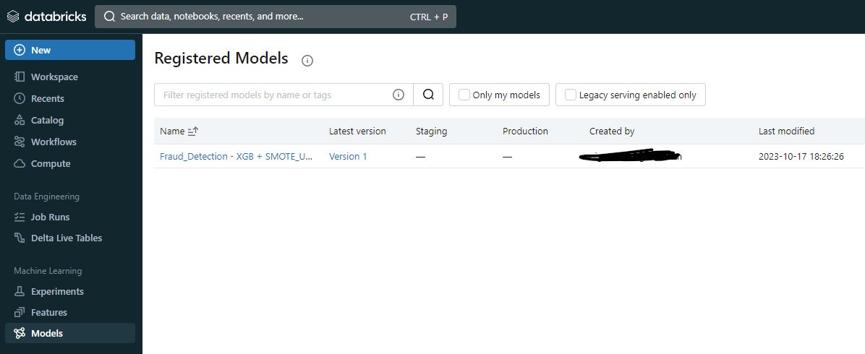
MLFlow implementation
The model was successfully registered to DataBricks
Undersampled version was used for faster processing in DataBricks

Slide 19
Thank You!

